Slide 1
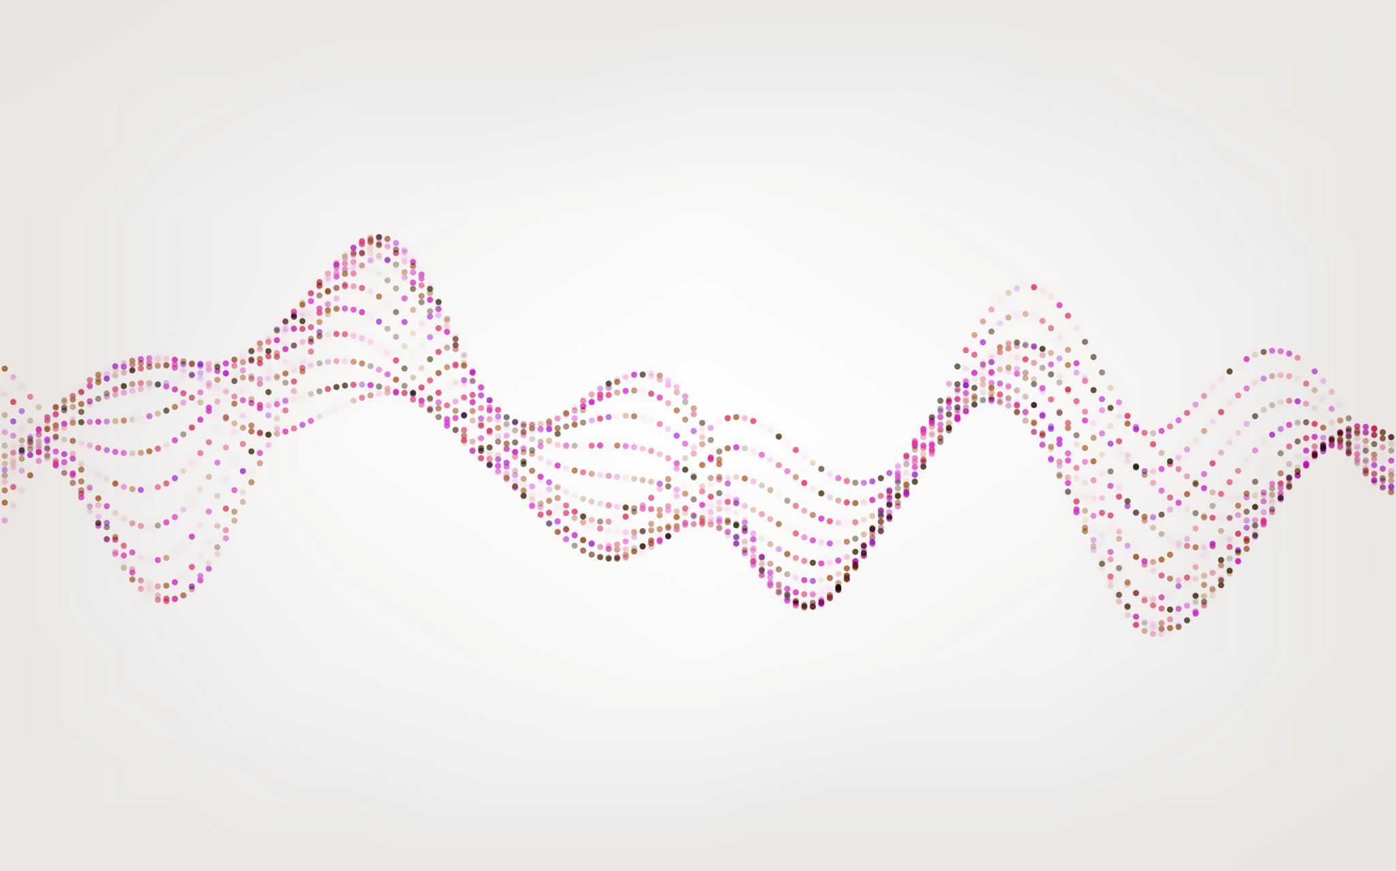
AI Deployment Environments and Requirements
Matthew Lima and Krishu Nakarmi
ELE548-Computer Architecture

Slide 2
Agenda
Topic Overview
Model Overview
Windows Implementation
Results
Raspberry Pi Implementation
Conclusion
FPGA Implementation
Data Analysis

Slide 3
Topic Overview
Deep Neural Networks (DNNs) are becoming more pervasive throughout everyday life.
Trending towards training on the cloud and inference on the edge [1].
Contains a different set of requirements than traditional cloud-based inference.
More focused on power-efficiency and reliability than performance and accuracy.
Need quantitative metrics to determine the best platform to deploy a DNN.
Will depend on a range of factors such as model type, deployment requirements, etc.
Goal: Create a simple DNN and use it on different platforms to evaluate various factors and metrics.

Slide 4
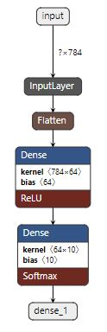
Model Overview
Simple Modified National Institute of Standards and Technology (MNIST) Optical Character Recognition (OCR) [2].
Original goal was YOLOv3-tiny objection detection Convolutional Neural Network (CNN).
MNIST dataset contains 70,000 hand-written digits (0 – 9).
60K were used for training
10K were used for evaluation.
Three-layer topology: Input Layer, Hidden Layer, Output Layer

Slide 5
Data Analysis
Three metrics were used to evaluate each of the platforms:
Accuracy
Performance
Power Efficiency
Each test was run multiple times to ensure the data collected was valid.
Windows: Ran each test 100 times (both with and without GPU acceleration).
FPGA: Performance was run 25 times (both with and without FPGA acceleration).
Raspberry Pi: Ran each test 100 times (without GPU acceleration).

Slide 6
Windows Implementation I
Hardware
Software
Ryzen 7 5800X3D Processor
64GB DDR4 Memory
GeForce RTX 3060 GPU
12GB GDDR6 Memory
WSL-2
Python
PyCharm
Open Hardware Monitor

Slide 7
Windows Implementation II
First of the platforms implemented.
Easiest and most well documented.
Model was trained and quantized on Windows and deployed to other platforms.
Mirrors most real-world DNN deployments.
Implemented using Keras with a TensorFlow backend.
Allowed for easy Graphical Processing Unit (GPU) integration.

Slide 8
Raspberry Pi Implementation I
Hardware
Software
Raspberry Pi Model 4B.
4x Cortex-A72 1.8 GHz
8GB LPDDR4-3200 SDRAM
128GB SD Card
Raspberry Pi OS 64-bit.
Expected an overall boost of about 25% in performance over the 32-bit version.
On 32-bit system, one process can only use ~3 GB of RAM, with ~1GB being reserved for system use.
Python for interfacing.
Thonny IDE

Slide 9
Raspberry Pi Implementation II
Most challenging part was the memory management
Limited memory to load and process huge dataset at the same time
Code modification to run the prediction model in the batch of 100 samples at the time

Slide 10
FPGA Model
Required the quantizing of the TensorFlow parameters to fit on the FPGA.
Needed to convert the trained weights and biases from float32 to int8 to fit on the FPGA.
Quantization was done using TFLite and Netron.
TFLite: Library designed to aid in the deployment of TensorFlow models to edge devices.
Netron: DNN model viewer with the ability to export weights and biases.
After quantizing the model parameters, a simple Python script was written to convert the NumPy arrays to C arrays.
This was used to synthesize the trained parameters into the FPGA logic.

Slide 11
FPGA Implementation I
Hardware
Software
PYNQ-Z2 FPGA development board.
Zynq-7000 System-on-a-Chip (SOC).
FPGA with 85K logic cells.
Dual ARM Cortex-A9 cores.
512MB DDR3
128GB SD Card
Ubuntu-based Operating System (OS) running on the ARM cores.
Vitis-HLS for developing custom FPGA DNN logic.
Vivado for connecting DNN logic to the ARM cores.
Python for interfacing with the logic.

Slide 12
FPGA Implementation II
FPGA development was broken into two parts:
Logic development
Creating the hardware accelerator for the DNN calculations.
Software development
Accessing the hardware accelerator from Linux and using it for evaluation.
Most difficult task was getting the DNN to fit in the FPGA logic.
Originally tried to use the float32 parameters, but it was too costly to fit.
Had to use the quantized int8 parameters and use int32 operations for the inference.

Slide 13
FPGA Implementation III: HLS
High Level Synthesis (HLS) was used to implement the DNN logic in the FPGA.
Component has a dedicated input and output stream port to receive data (MNIST images) and transmit the result (10-word vector).
Weights and biases are stored in const int8 and int32 arrays, respectively.
All operations are done in int32 to preserve accuracy. Weights are stored as int8 to preserve memory.

Slide 14
FPGA Implementation IV: Software
PYNQ platform comes pre-loaded with Jupyter Notebook and custom libraries to interface with FPGA logic.
A custom software driver was written that utilizes these libraries to make it simple to interface with the logic.
Image(s) can be loaded onto the DDR memory and transferred to the logic using a Direct Memory Access (DMA) controller.
After pre-allocating the memory region for the DMA, a single function call can initiate the logic operation and return the result.
Similar to the TensorFlow predict method.

Slide 15
Results I

Slide 16
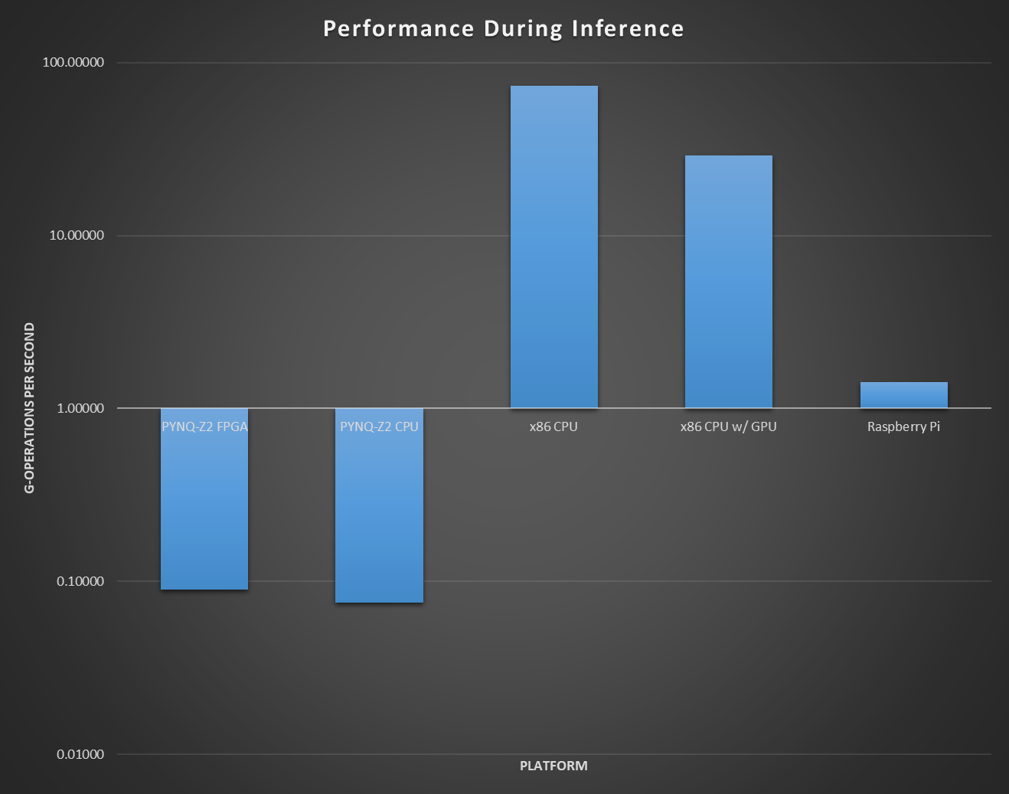
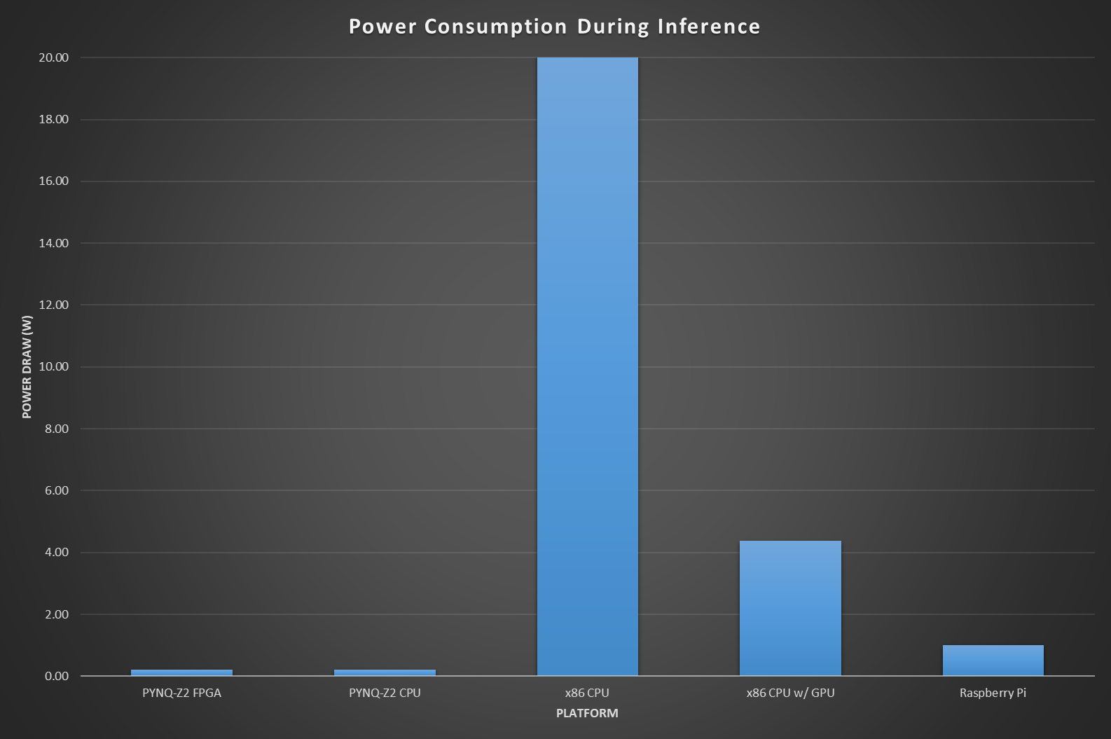
Results II

Slide 17
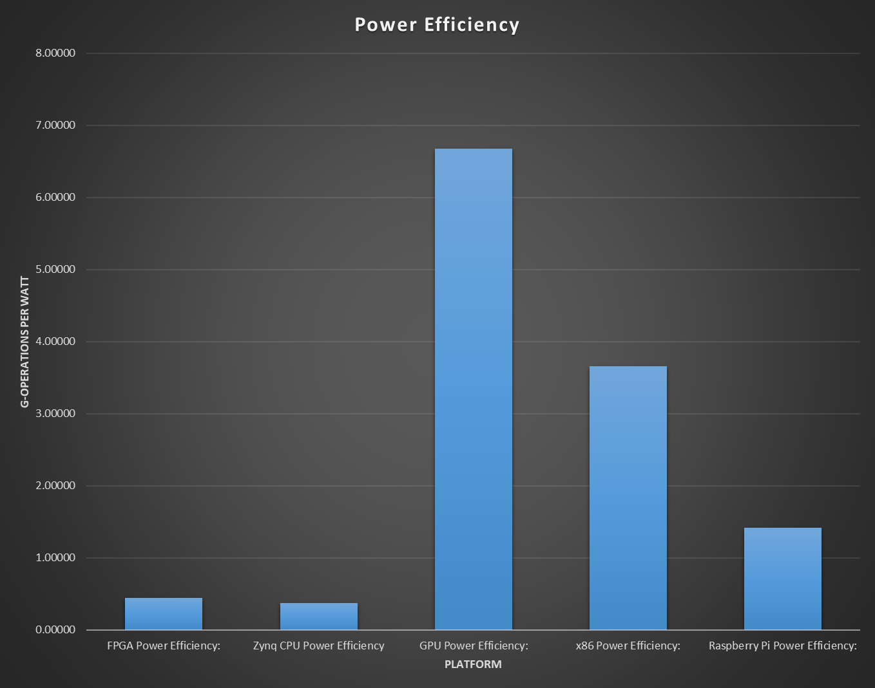
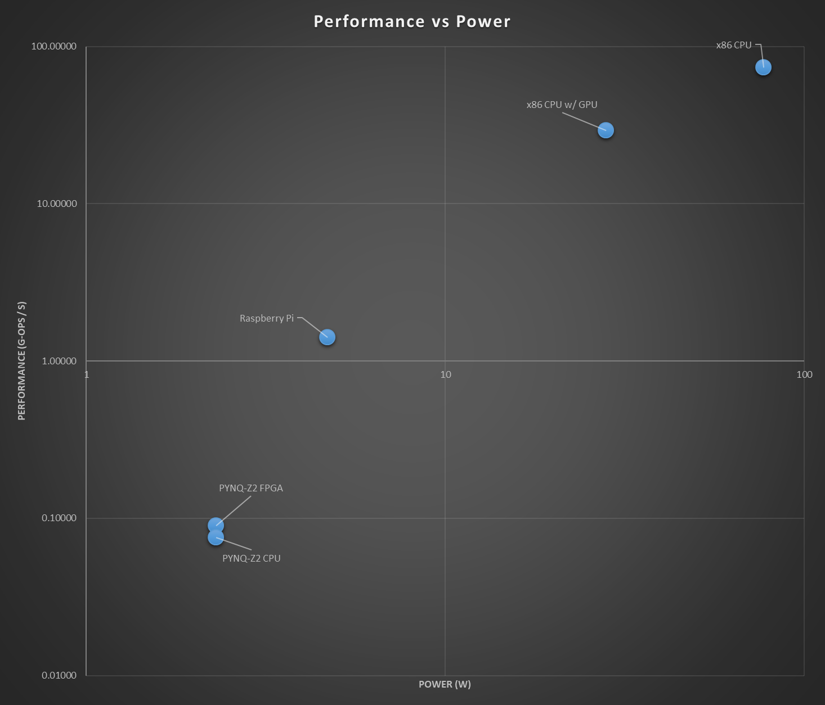
Results III

Slide 18
Conclusion
Highest Performance: x86 CPU
Most likely due to small model size. GPU was expected to be the most performant.
Most Power Efficient: GPU
Doesn't take into account the CPU necessary to run the GPU.
Best Power Draw: FPGA
Smallest power draw while still maintaining reasonable performance.

Slide 19
References
[1] K. Cao, Y. Liu, G. Meng and Q. Sun, "An Overview on Edge Computing Research," in IEEE Access, vol. 8, pp. 85714- 85728, 2020, doi: 10.1109/ACCESS.2020.2991734.
[2] L. Deng, “The mnist database of handwritten digit images for machine learning research,” IEEE Signal Processing Magazine, vol. 29, no. 6, pp. 141–142, 2012.

Slide 20

Questions?

